Slide 1

Airbnb Price Prediction City of Boston
Group 6 - Final Group Project
August 2021
Notes:
Intro: Geetha Shanthibushan
Welcome to Group 6 Final Project Presentation.
Our project is on Airbnb Price Prediction for City of Boston.

Slide 2

Team Members
Syed Ahmed
Pascal Duchesneau
Raissa Fondjo
Geetha Shanthibushan
Lalchand Shivraj
Notes:
Geetha Shanthibushan
Let me introduce you my team:xxxx

Slide 3

Overview
Customers select rental based on price, convenient location, reviews, and household amenities.
Estimating a price for short time stay lodging is a difficult task.
Therefore, our team decided to develop a price prediction model using machine learning.
Notes:
Geetha Shanthibushan
Why would someone select Airbnb accommodations vs Hotel/Model stay?
low cost, convenient location, reviews, household amenities; which create different experience than the traditional hotel rental.
How would customer know that they are paying the right price?
So our team decided to develop a price prediction model using machine learning.

Slide 4
Objective
Build a model that predicts the ideal price of a property taking into account listing features.
Presentation
Technologies
Data Exploration & Analysis
Database
Machine Learning
Dashboard
Notes:
Geetha Shanthibushan
Our objective was to build a model that predicts the ideal price using the listing features from the dataset.
In this presentation we are going to cover the followings:
The technologies that we used to for this project, Preliminary Data Exploration, Creation of the Database, Machine Learning model and outcome and the Visual treat “the Dashboard”

Slide 5






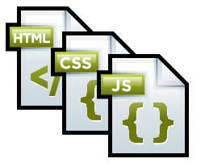





What we used
Dataset
Database
Language
Tools
Technologies
Algorithms
Linear Regression
Decision Tree
Random Forest
Deep Learning
Notes:
Geetha Shanthibushan
We selected Airbnb datasets from Kaggle
To create Database we used PostgreSQL & MongoDB
Programing language used: Python, HTML, CSS & JS
As a source code editor and Tool, we used Visual Studio Code, jupyter Notebook & GitHub
As a web technologies utilized QuickDBD, tableau, Heroku, GitHub Pages
Machine Learning model algorithms used Linear Regression, Decision Tree, Random Forest & Deep Learning.

Slide 6

Preliminary Data Analysis
What are the key factors that affect the price of the rental property?
Which neighborhoods in Boston have the highest rental prices?
Popular neighborhood comparison with Number of listings, Average Price, Review Scores
Room Type
Property Type
Number of Reviews
Amenities
Neighborhoods are separated into 25 districts.
The price contributing factor differ significantly across the neighborhoods because of the variation in neighborhoods types.
Neighborhood with fewer listings have higher average listing price and review scored below median.
Neighborhood with higher listings have lower average listing price and reviewed scored above median.
Notes:
Geetha Shanthibushan
For the preliminary Data Analysis, we used visual analysis method to understand the dataset and to answer our questions. This technique was the faster way for us to understand the dataset and to design our machine learning model.
What are the key factors that affect the price of the rental property? Room Type, Property Type, Number of Reviews, Amenities
Which neighborhoods in Boston have the highest rental prices?
In the dataset the Neighborhoods are separated into 25 districts and based on analysis, The price contributing factor differ significantly across the neighborhoods because of the variation in neighborhoods types.
Popular neighborhood comparison with Number of listings, Average Price, Review Scores?
Neighborhood with fewer listings have higher average listing price and review scored below median.
Neighborhood with higher listings have lower average listing price and reviewed scored above median.

Slide 7

Data Exploration The ETL Process
Extract
Two datasets containing AirBnB listings and Reviews were obtained from Kaggle. We reviewed the columns in the listings dataset and decided on which to keep.
Transform
Transform data, removing null values and unnecessary columns, and joining datasets.
Load
Load the data by writing it into PostgresSQL, two tables were created to house the datasets.
Notes:
Lalchand Shivraj

Slide 8
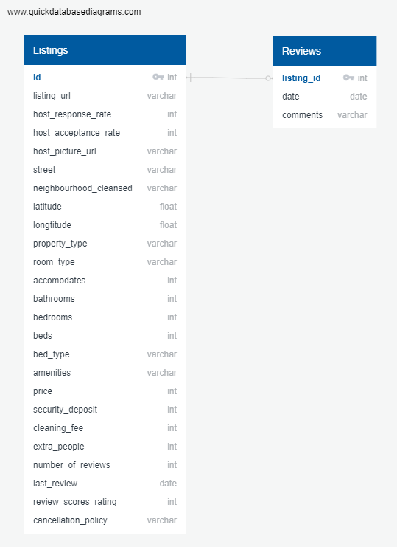

Database
Used postgres by way of pgAdmin as our database to house the tables of data.
In MongoDB a cluster was created to access the data for multiple users.
The dataset was then imported into a database created on MongoDB, using
MongoDB Compass
Notes:
Lalchand Shivraj

Slide 9

Machine Learning
Notes:
Syed Ahmed
To run our machine learning models, data was retrieved from a MongoDB database using MongoDB Compass.
The first step was to convert all numeric variables into int / float format for processing.
Next, we checked for nulls and decided to drop the null values since it accounted for a small percentage of our rows.
Once this was done, we encoded all categorical variables into numerical values that can be read by a Machine Learning algorithm.

Slide 10
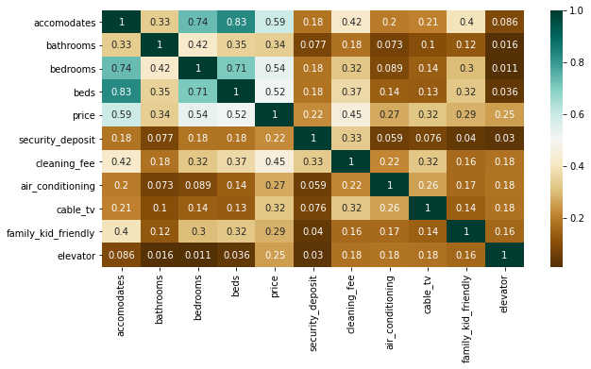
Heatmap: Features Correlation
Exploratory Analysis:
X variables included the features shown in the correlation matrix above, and our 'y' variable was price.
Notes:
Syed Ahmed
In our exploratory analysis, we created a statistical summary of our variables so we could assess our measures of central tendency and try to identify outliers.
The next step was to use corr() to find variables that have a strong correlation with our target variable, price. We chose variables with a correlation coefficient above 0.20 to be used as features in our machine learning model.

Slide 11
Split of Train & Test Data
Statistical Modeling Methodology
Train Data
70%
Test Data
30%
Regression Models
Random Forest Regressor
Linear Regression
Decision Tree Regression
Notes:
Syed Ahmed
With preprocessing complete, and features selected, we were ready to start testing our machine learning models.
Our X variables included the features shown in the correlation matrix from the previous slide, and our 'y' variable was price.
We split the data into training and testing sets with a random state of 45, test size of 30% and training set size of 70%.
We chose three different types of regression models to predict our target variable: Random Forest Regressor, Linear Regression, and Decision Tree regression.
We wanted to see how these three different models will perform, and which one of them will give us the highest R squared value.

Slide 12
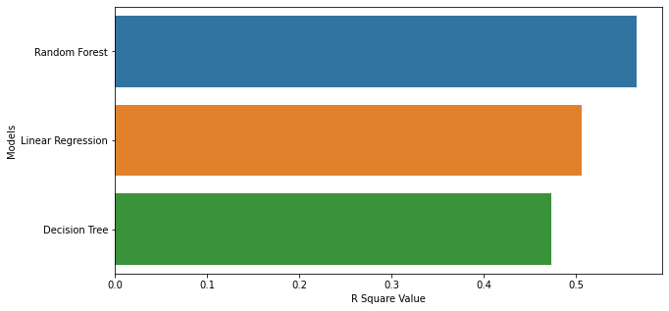
R Square Value
Regression Models:
Notes:
Syed Ahmed
Our initial testing with ML models resulted in the R squared values we can see on the screen.
The Random Forest Regressor model gave us the highest R squared value (0.56) out of all models tested.
This was followed by the Linear Regression Model, which gave us an R squared value of 0.51.
Furthermore, the Decision Tree model gave us an R squared value of 0.47, which was the lowest of all models tested.

Slide 13
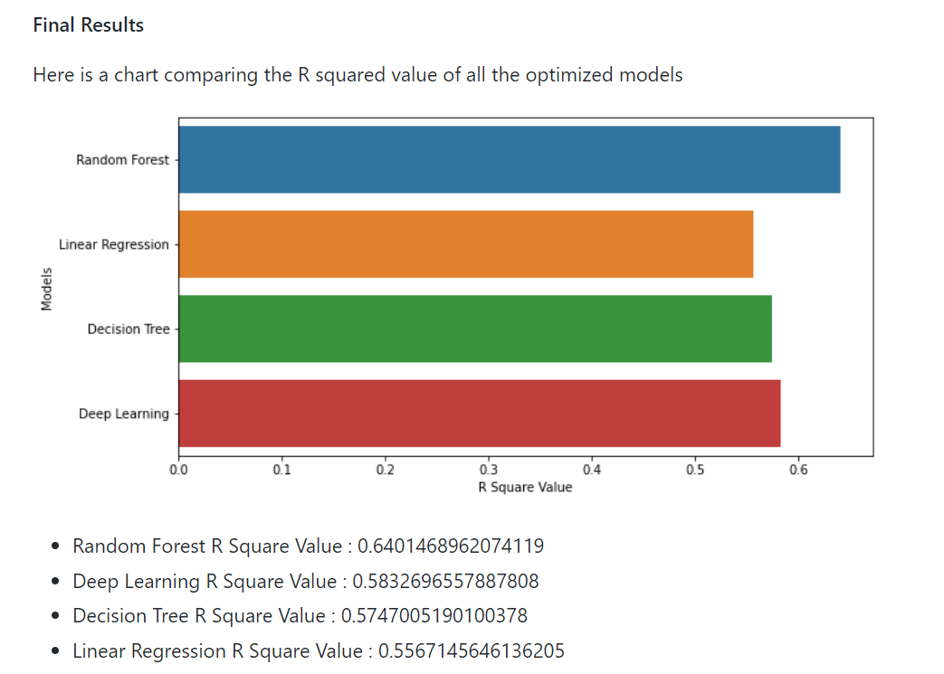
Model Optimization
Statistical Modeling Methodology
Train Data
67%
Test Data
33%
Final Results
Notes:
Syed Ahmed
After the initial testing of our machine learning models, we worked on optimizing them by changing the train test split to 67% and 33% respectively and removing outliers that were present in the ‘price’ variable that were giving the data a right skew, as well as re-selecting appropriate features from the dataset based on a higher correlation coefficient than the one previously selected (0.25) and including negative correlations this time.
We also added a Deep Learning Model with two hidden layers. These are the final R squared values we came up with.

Slide 14
Recommendation
Recommendation for future analysis
Use a logarithmic scale on the target variable
Supplement data with more current data from Airbnb
Add unsupervised learning to cluster patterns within the dataset, which could uncover relationships within variables
Performing a qualitative assessment of how reviews affect Airbnb price
Notes:
Syed Ahmed
Although we spent quite some time optimizing our machine learning models to produce an R squared value closer to 1, there are some changes that should be considered for future analysis. One of those considerations would be to perhaps use a logarithmic scale on the target variable, to further reduce the skewness towards large values in the dataset. This would give us a more normalized distribution to work with, which may enhance our results.
We could also have look at more current data and see what impact COVID 19 has had on Airbnb pricing and reviews.
Adding a unsupervised learning model could also potentially help us uncover patterns within the data that we may have missed in our exploratory analysis.
Another consideration for future analysis would be to perform a sentiment analysis on customer reviews to see what effect they have on price.

Slide 15

Dashboard
For the dashboard segment of this project, we will be using:
The Visual Analysis: Tableau
The Interactive Elements: Heroku
The Website: Price Prediction
Notes:
Pascal:
we used Tableau for visualization of various parameters affecting price and looked for correlation
We won’t go over the graphs but they were included on
the website, which we’ll comeback to in a minute
Also, we deployed
an interactive map on Heroku showing details of the top 200 listings based on
star review.
If we click
on the pins it displays the listing information

Slide 16
Improvements
What we would have done differently
•Explore more data sources to find more factors that could influence rental price.
•Data source from InsideAirbnb instead of Kaggle.
Notes:
Taking more time to discover more data sets and factors that may influence rental price.
Learned after the fact InsideAirbnb contains dataset of Airbnb cities around the world; it has the current data.

Slide 17
Airbnb Price Prediction City of Boston
Thank you!
Notes:
Thank you for listening!

